Slide 1
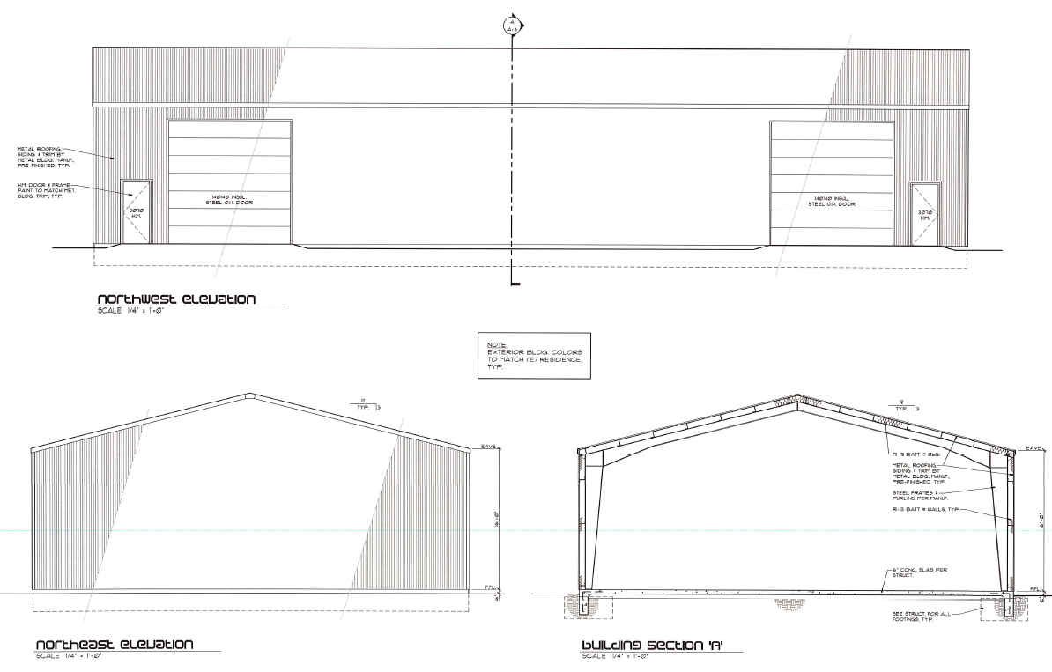
ADMINISTRATIVE PERMIT CASE NUMBER WADMIN19-0004
Wilder Detached Accessory Structure
Washoe County Board of Adjustment
May 2, 2019

Slide 2
Request
Detached Accessory Structure 5000 square feet in size, that is larger than the main dwelling which is 3,107 square feet in size.

Slide 3
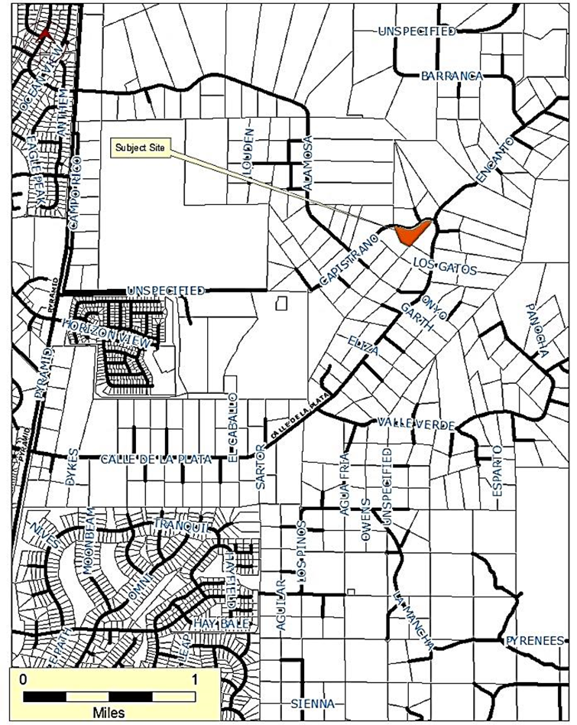
Vicinity Map

Slide 4
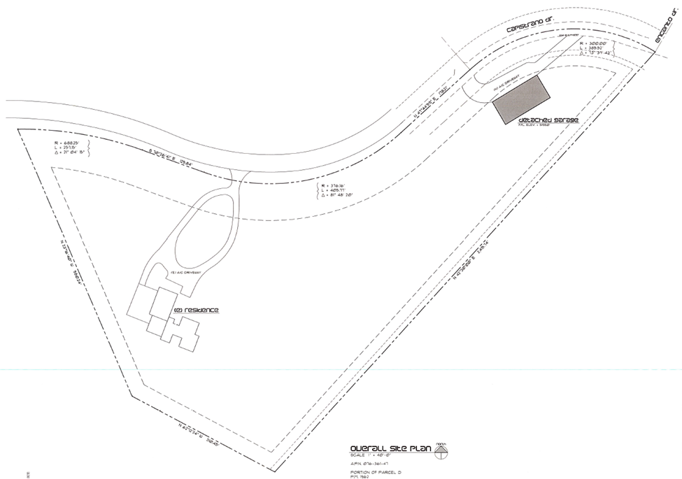
Site Plan

Slide 5
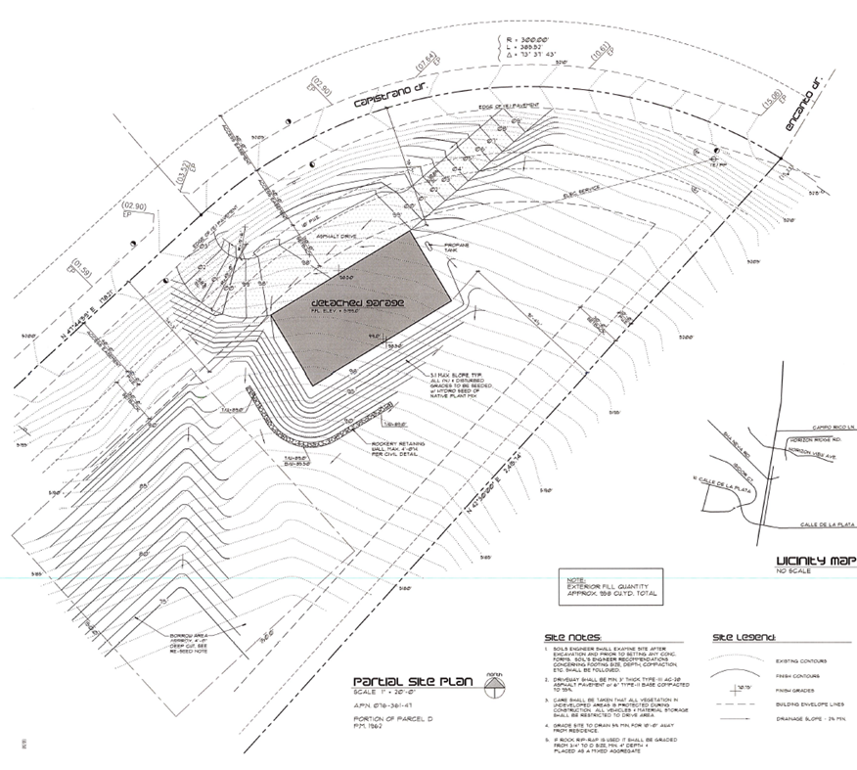
Overview
Grading:
1) Revegetation (with irrigation)
2)tree preservation and replacement

Slide 6
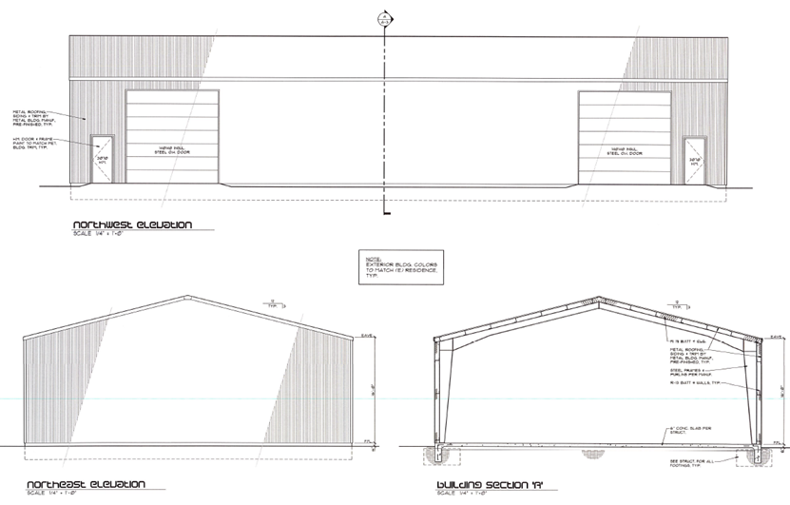
Overview
Design: Same colors as dwelling

Slide 7
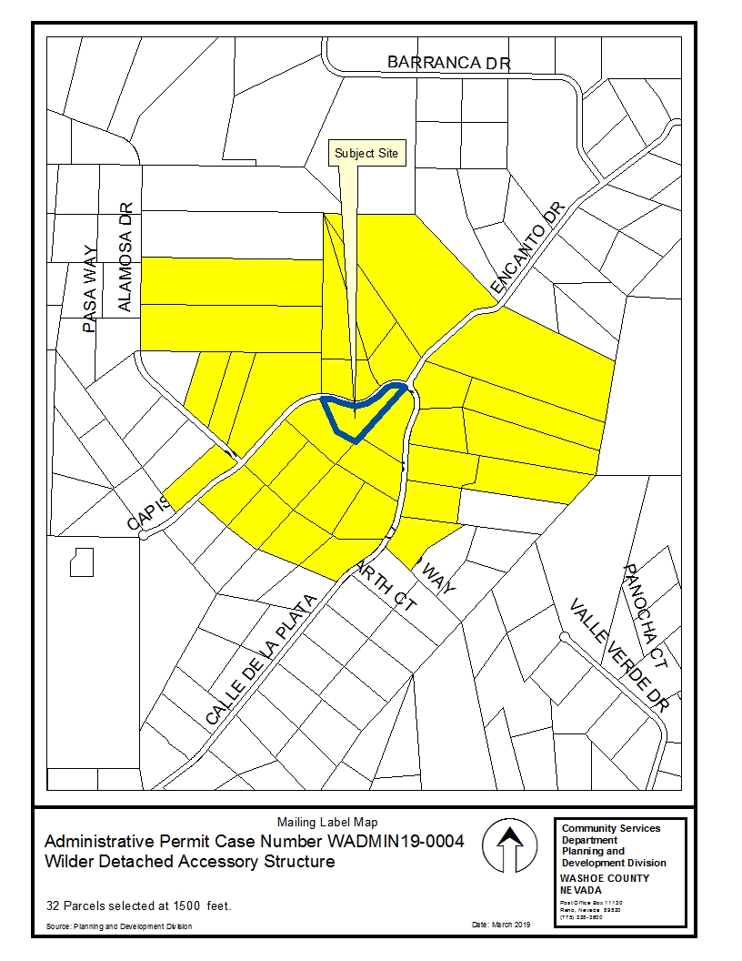
Public Notice & CAB
Notice sent to 32 affected property owners
Spanish Springs CAB reviewed the application on April 3, 2019.

Slide 8
Reviewing Agencies
Washoe County Community Services Department
  Engineering and Capital Projects Division
  Parks and Open Spaces
  Planning and Building Division
Washoe County Health District
  Vector-Borne Diseases Program
  Environmental Health Services Division
  Air Quality Management Division
Washoe County Sheriff
Washoe County Regional Animal Services
Truckee Meadows Fire Protection District
Regional Transportation Commission
Washoe – Storey Conservation District

Slide 9
Conditions of Approval
No unique or extraordinary conditions of approval were recommended by any of the reviewing agencies.

Slide 10
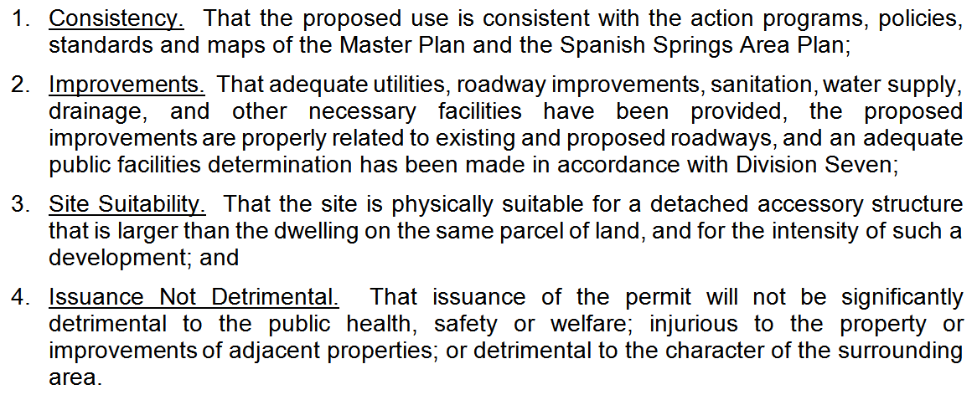
Administrative Permit Findings
Comments on each finding are included on pages 8 and 9 of the Staff Report

Slide 11
Recommendation
Those agencies which reviewed the application recommended conditions in support of approval of the project. Therefore, after a thorough analysis and review, Administrative Permit Case Number WADMIN19-0004 is being recommended for approval with conditions.

Slide 12
Possible Motion
I move that, after giving reasoned consideration to the information contained in the staff report and information received during the public hearing, the Board of Adjustment approve Administrative Permit Case Number WADMIN18-0004 for Matthew Wilder, having made all four findings in accordance with Washoe County Development Code Section 110.808.25.

